Slide 1
Gender Transformation using Adversarial Networks
-Rahul Ethiraj
-Sithara Kamalakkannan

Slide 2
Problem Description
Image translation for Gender in Face Datasets
That is, given a male, the Generator should successfully produce a female version of the same person and vice versa

Slide 3
How did GANs come into being?
GANs were introduced in a paper by Ian Goodfellow and other researchers at the University of Montreal
Called “the most interesting idea in the last 10 years in ML”, by Facebook’s AI research director Yann LeCun
A generative model learns the joint probability distribution p(x,y) and a discriminative model learns the conditional probability distribution p(y|x)
Notes:
//https://www.cs.toronto.edu/~duvenaud/courses/csc2541/slides/gan-foundations.pdf

Slide 4
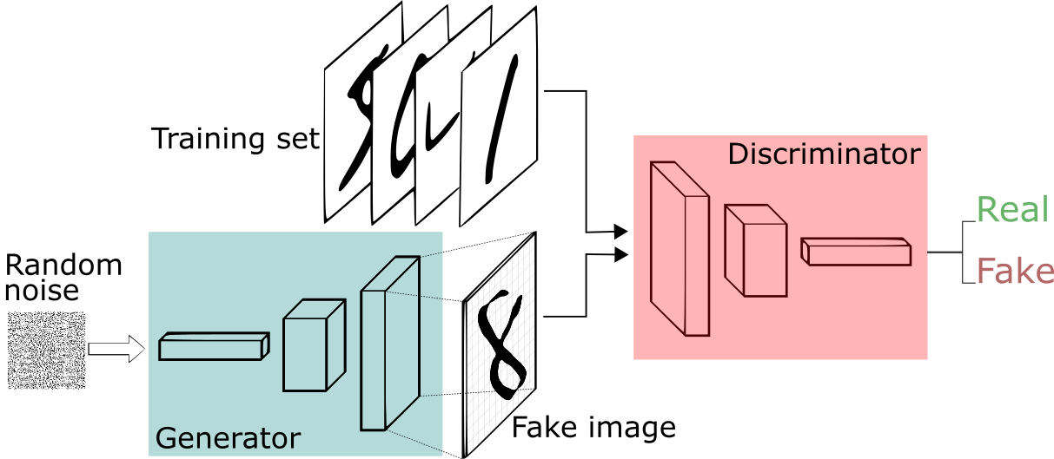
What are GANs?

Slide 5
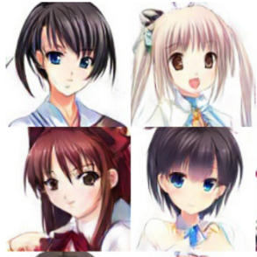
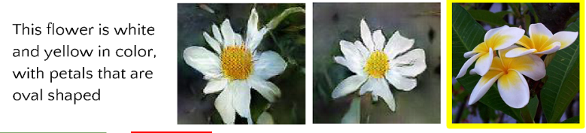
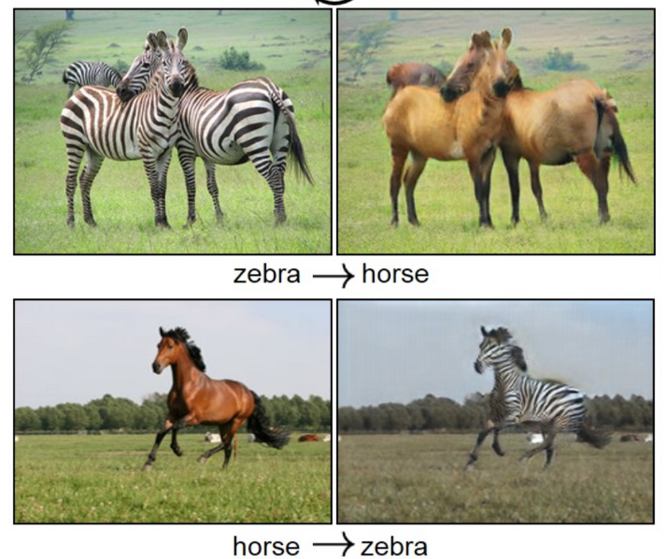
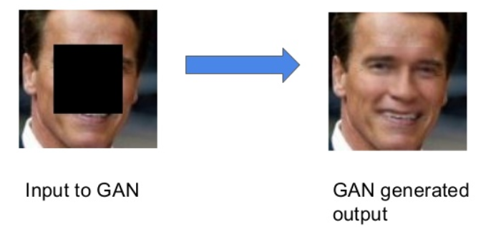
Applications of GAN
Create Anime characters
Cross Domain transfer Gan
Text to image
Inpainting

Slide 6
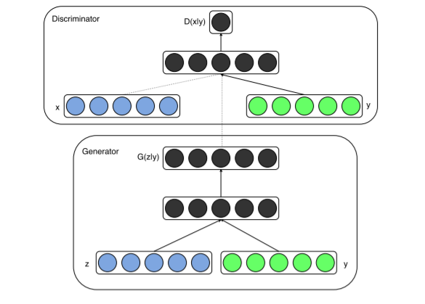
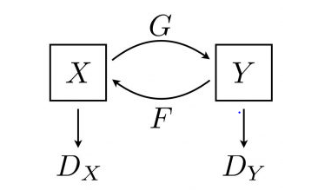
The Learning Process
Conditional Adversarial Nets:
Generative adversarial nets can be extended to a conditional model if both the generator and discriminator are conditioned on some extra information y. y could be any kind of auxiliary information, such as class labels or data from other modalities
Cycle Gan:
Cycle GANs are able to learn great translations without having explicit X/Y training images by introducing the idea of a full translation cycle to determine how good the entire translation system is, thus improving both generators at the same time

Slide 7
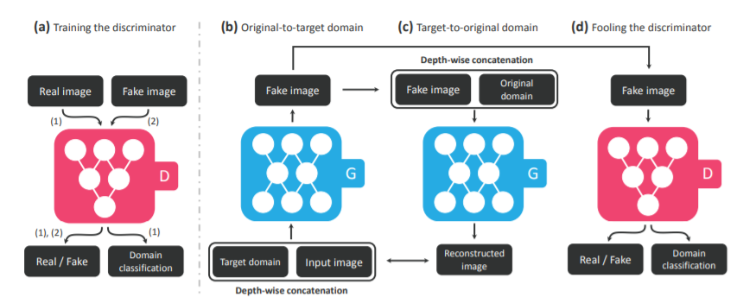
StarGan Architecture

Slide 8
Network Architecture
Generator
(h, w, 3 + n_{c}) → (h, w, 64)| CONV-(N64, K7x7, S1, P3), IN,ReLU
Down-sampling:
(h, w, 64) → ( h/2 , w/2 , 128)| CONV-(N128, K4x4, S2, P1), IN, ReLU
( h/2 , w/2 , 128) → ( h/4 , w/4 , 256) |CONV-(N256, K4x4, S2, P1), IN, ReLU
BottleNeck (6):
( h/4 , w/4 , 256) → ( h/4 , w/4 , 256)
Residual Block: CONV-(N256, K3x3, S1, P1), IN, ReLU
Up-Sampling:
( h/4 , w/4 , 256) → ( h/2 , w/2 , 128) DECONV-(N128, K4x4, S2, P1), IN, ReLU
( h/2 , w/2 , 128) → (h, w, 64) DECONV-(N64, K4x4, S2, P1), IN, ReLU
(h, w, 64) → (h, w, 3) CONV-(N3, K7x7, S1, P3), Tanh
Discriminator
Input Layer:
(h, w, 3) → ( h/2 , w/2 , 64) CONV-(N64, K4x4, S2, P1), Leaky ReLU
Hidden Layer (5):
( h/2 , w/2 , 64) → ( h/4 , w/4 , 128) CONV-(N128, K4x4, S2, P1), Leaky ReLU
…
( h/32 , w/32 , 1024) → ( h/64 , w/64 , 2048) CONV-(N2048, K4x4, S2, P1), Leaky ReLU
Output Layer
(D_{src}): ( h/64 , w/64 , 2048) → ( h/64 , w/64 , 1) CONV-(N1, K3x3, S1, P1)
(D_{cls}): ( h/64 , w/64 , 2048) → (1, 1, n_{d}) CONV-(N(n_{d}), K h/64 x w/64 , S1, P0)

Slide 9
Dataset Description
Training Dataset : CelebA Dataset
202,599 number of face images
40 binary attributes annotations per image
Testing Dataset : Imdb, Wiki Dataset

Slide 10


Loss Evaluation Criteria
Adversarial Loss :
Domain Classification Loss:
Reconstruction Loss:
Objective Function:
L_{D} = −L_{adv} + λ_{cls} L ^{r} _{cls}
L_{G} = L_{adv} + λ_{cls} L ^{f} _{cls} + λ_{rec} L_{rec}
D_{src}: probability distribution over sources given by D
D_{cls} : D: Domain classification loss of real image, G: Domain classification loss of fake images used to optimize G
L_{rec} : G takes in the translated image G(x, c) and the original domain label c’ as input and tries to reconstruct the original image x.
We adopt the L1 norm as our reconstruction loss

Slide 11
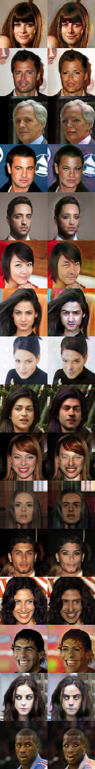
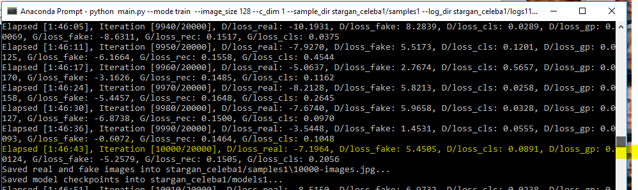
Results

Slide 12
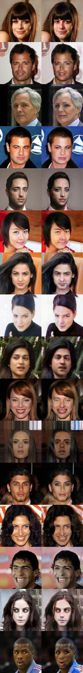
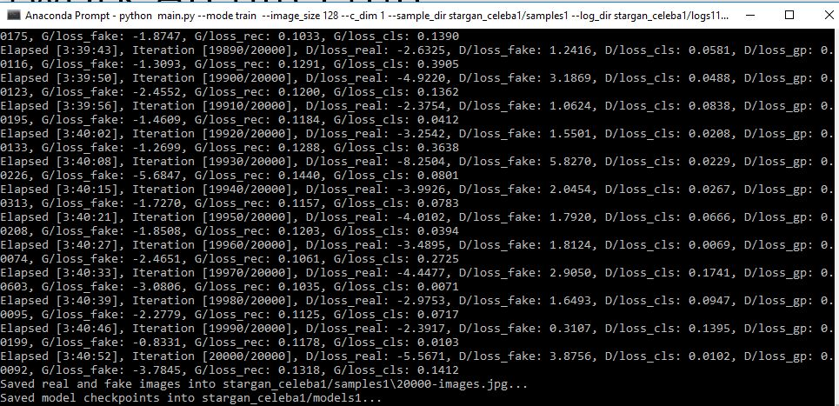

Slide 13
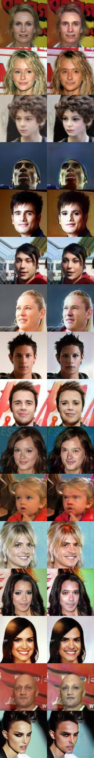
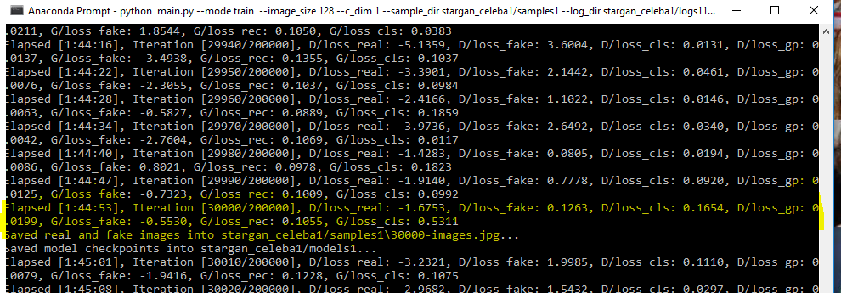

Slide 14
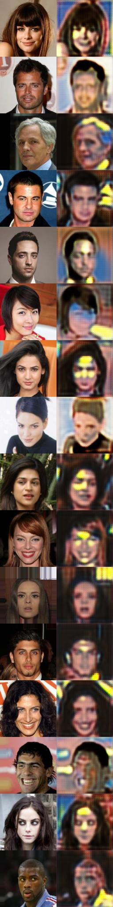
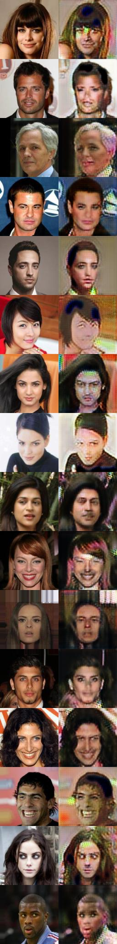
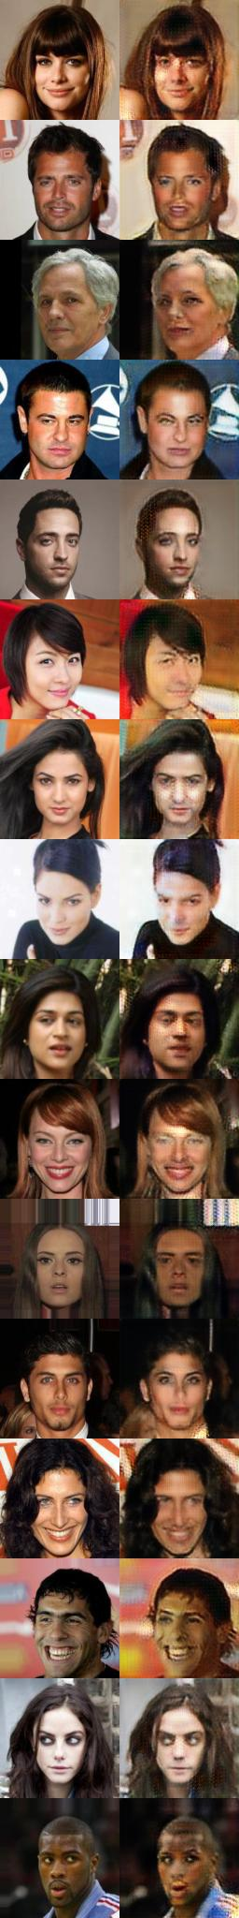

Slide 15
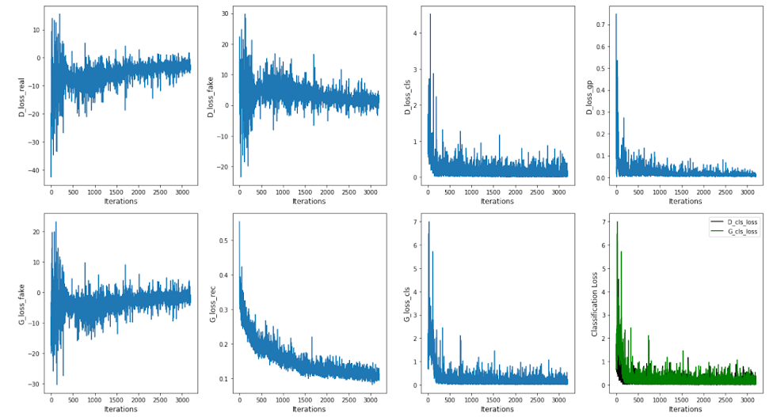

Slide 16
Difficulties Faced
Compatibility Issues between Tensorflow-gpu, CUDA, CDNN, VisualStudio, pyTorch
Shortage of Computation Resources
Unavailability of clean Face Datasets that have gender labels
AWS EC2 GPU instance

Slide 17
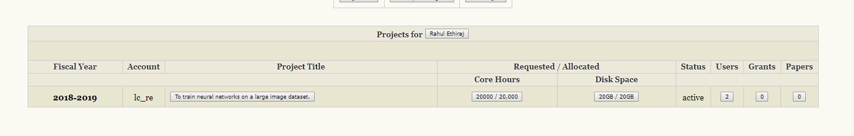
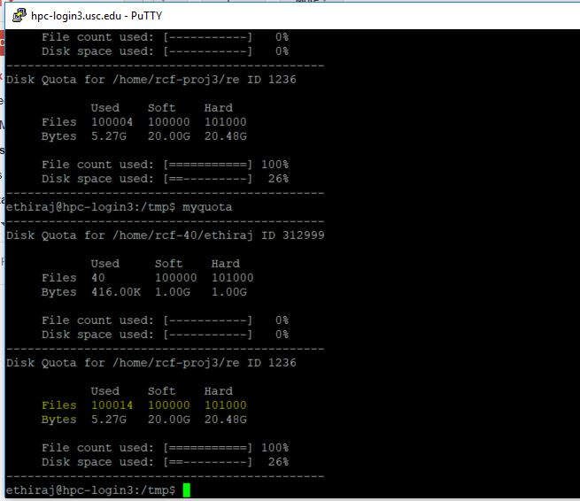
USC HPC

Slide 18
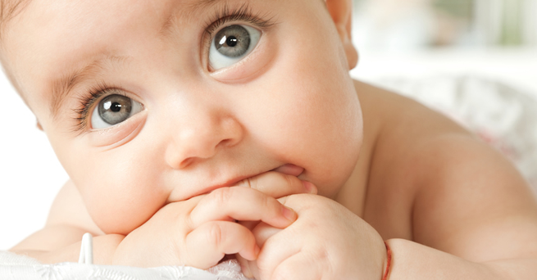
Unavailability of clean Face Datasets

Slide 19


